Slide 1
INTERNSHIP STUDIO ETHICAL HACKING PROJECT TASK 3
Find Any Vulnerability In Website Testasp.Vulnweb.Com And Make A Report

Slide 2
report

Slide 3
summary
website https://testasp.vulnweb.com has an endpoint that is vulnerable to an injection vulnerability - namely a reflected injection of JavaScript, also known as Reflected Cross Site Scripting (XSS). As per OWASP's definition: "Cross-Site Scripting (XSS) attacks are a type of injection, in which malicious scripts are injected into otherwise benign and trusted websites. " This happens because one of the GET parameters "p" does not properly sanitize/escape user input, allowing an injection to occur.

Slide 4
description
Cross-site Scripting (XSS) is an attack technique that involves echoing attacker-supplied code into a user's browser instance. A browser instance can be a standard web browser client, or a browser object embedded in a software product such as the browser within WinAmp, an RSS reader, or an email client. The code itself is usually written in HTML/JavaScript, but may also extend to VBScript, ActiveX, Java, Flash, or any other browser-supported technology.
When an attacker gets a user's browser to execute his/her code, the code will run within the security context (or zone) of the hosting web site. With this level of privilege, the code has the ability to read, modify and transmit any sensitive data accessible by the browser. A Cross-site Scripted user could have his/her account hijacked (cookie theft), their browser redirected to another location, or possibly shown fraudulent content delivered by the web site they are visiting. Cross-site Scripting attacks essentially compromise the trust relationship between a user and the web site. Applications utilizing browser object instances which load content from the file system may execute code under the local machine zone allowing for system compromise.
There are three types of Cross-site Scripting attacks: non-persistent, persistent and DOM-based.
Non-persistent attacks and DOM-based attacks require a user to either visit a specially crafted link laced with malicious code, or visit a malicious web page containing a web form, which when posted to the vulnerable site, will mount the attack. Using a malicious form will oftentimes take place when the vulnerable resource only accepts HTTP POST requests. In such a case, the form can be submitted automatically, without the victim's knowledge (e.g. by using JavaScript). Upon clicking on the malicious link or submitting the malicious form, the XSS payload will get echoed back and will get interpreted by the user's browser and execute. Another technique to send almost arbitrary requests (GET and POST) is by using an embedded client, such as Adobe Flash.
Persistent attacks occur when the malicious code is submitted to a web site where it's stored for a period of time. Examples of an attacker's favorite targets often include message board posts, web mail messages, and web chat software. The unsuspecting user is not required to interact with any additional site/link (e.g. an attacker site or a malicious link sent via email), just simply view the web page containing the code.

Slide 5
information
Reflected attacks are those where the injected script is reflected off the web server, such as in an error message, search result, or any other response that includes some or all of the input sent to the server as part of the request. Reflected attacks are delivered to victims via another route, such as in an e-mail message, or on some other website. When a user is tricked into clicking on a malicious link, submitting a specially crafted form, or even just browsing to a malicious site, the injected code travels to the vulnerable web site, which reflects the attack back to the user’s browser. The browser then executes the code because it came from a “trusted” server. Reflected XSS is also sometimes referred to as Non-Persistent or Type-II XSS.

Slide 6
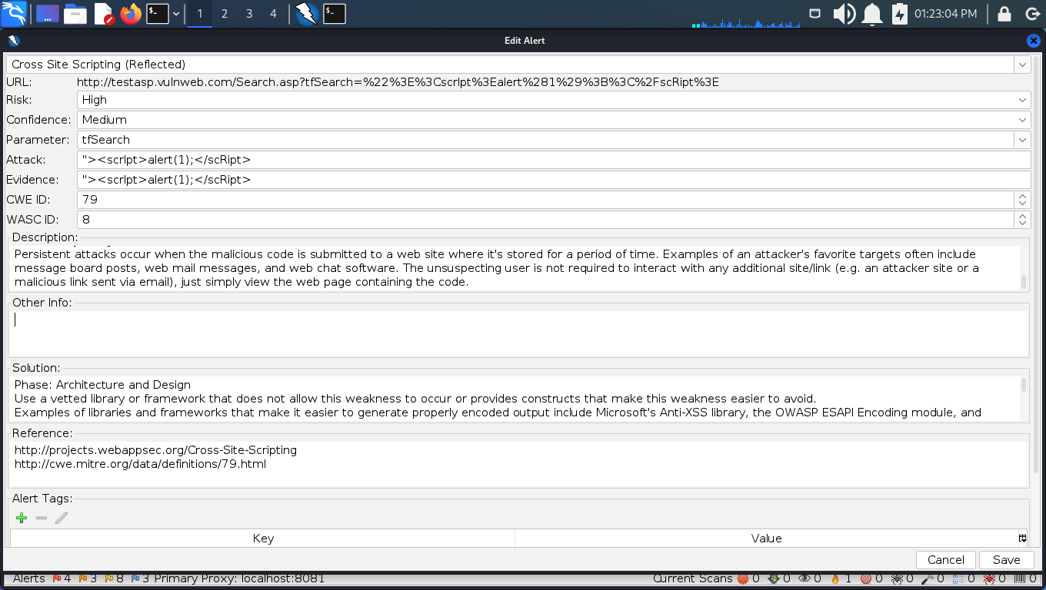
Poc:

Slide 7
STEPS TO REPRODUCE
To reproduce this, an attacker has to:
Prepare a Javascript payload that it wants the victim to execute. In this case, for Proof of Concept purposes, our Javascript code will prompt an alert showing the users' cookies.
Code :
><scrIpt>alert(1);</scRipt>
Inject this Javascript code properly into the vulnerable parameter, creating thus a crafted future GET request that will inject the payload.
Code :
GET /Search.asp?tfSearch=%3E%3CscrIpt%3Ealert%281%29%3B%3C%2FscRipt%3E HTTP/1.1
Host: testasp.vulnweb.com
User-Agent: Mozilla/5.0 (X11; Linux x86_64; rv:91.0) Gecko/20100101 Firefox/91.0
Accept: text/html,application/xhtml+xml,application/xml;q=0.9,image/webp,*/*;q=0.8
Accept-Language: en-US,en;q=0.5
Accept-Encoding: gzip, deflate
Connection: close
Referer: http://testasp.vulnweb.com/Search.asp?tfSearch=%3E%3CscrIpt%3Ealert%281%29%3B%3C%2FscRipt%3E
Cookie: ASPSESSIONIDCSTCTBRD=GNKAPDHCKCJGOAICPFKDNNEH
Upgrade-Insecure-Requests: 1

Slide 8
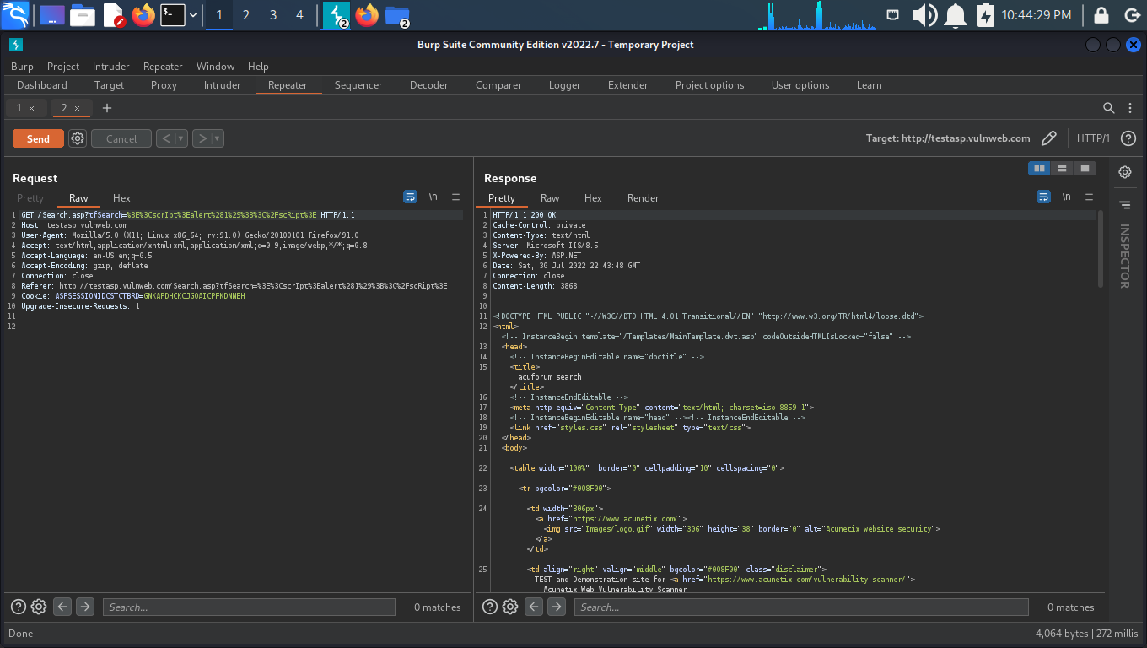
POC REQUEST

Slide 9
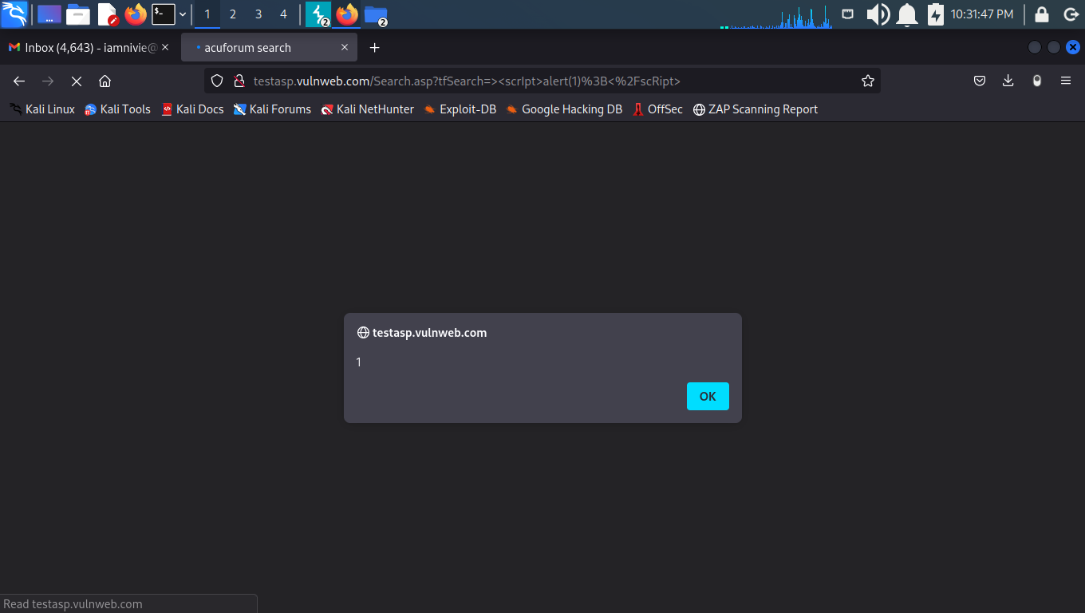
As this injection happens in a GET parameter, the attacker simply needs to send the crafted Link that produces this GET request to the victim and have the victim click it.
Injection Demonstration:

Slide 10

Supporting Material/References:
Video Demonstration:

Slide 11
IMPACT
With user interaction, an attacker could execute arbitrary Javascript code in a victim's browser. This would allow an attacker to unwillingly make a victim:
Perform any action in the identified endpoint
View any information that the user is able to view.
Modify any information that the user is able to modify (not sure if applicable in this case).
Interact with other application users as if it were him - impersonation (not sure if applicable in this case).

Slide 12
solution
Phase: Architecture and Design
Use a vetted library or framework that does not allow this weakness to occur or provides constructs that make this weakness easier to avoid.
Examples of libraries and frameworks that make it easier to generate properly encoded output include Microsoft's Anti-XSS library, the OWASP ESAPI Encoding module, and Apache Wicket.
Phases: Implementation; Architecture and Design
Understand the context in which your data will be used and the encoding that will be expected. This is especially important when transmitting data between different components, or when generating outputs that can contain multiple encodings at the same time, such as web pages or multi-part mail messages. Study all expected communication protocols and data representations to determine the required encoding strategies.
For any data that will be output to another web page, especially any data that was received from external inputs, use the appropriate encoding on all non-alphanumeric characters.
Consult the XSS Prevention Cheat Sheet for more details on the types of encoding and escaping that are needed.
Phase: Architecture and Design
For any security checks that are performed on the client side, ensure that these checks are duplicated on the server side, in order to avoid CWE-602. Attackers can bypass the client-side checks by modifying values after the checks have been performed, or by changing the client to remove the client-side checks entirely. Then, these modified values would be submitted to the server.
If available, use structured mechanisms that automatically enforce the separation between data and code. These mechanisms may be able to provide the relevant quoting, encoding, and validation automatically, instead of relying on the developer to provide this capability at every point where output is generated.

Slide 13
Phase: Implementation
For every web page that is generated, use and specify a character encoding such as ISO-8859-1 or UTF-8. When an encoding is not specified, the web browser may choose a different encoding by guessing which encoding is actually being used by the web page. This can cause the web browser to treat certain sequences as special, opening up the client to subtle XSS attacks. See CWE-116 for more mitigations related to encoding/escaping.
To help mitigate XSS attacks against the user's session cookie, set the session cookie to be HttpOnly. In browsers that support the HttpOnly feature (such as more recent versions of Internet Explorer and Firefox), this attribute can prevent the user's session cookie from being accessible to malicious client-side scripts that use document.cookie. This is not a complete solution, since HttpOnly is not supported by all browsers. More importantly, XMLHTTPRequest and other powerful browser technologies provide read access to HTTP headers, including the Set-Cookie header in which the HttpOnly flag is set.
Assume all input is malicious. Use an "accept known good" input validation strategy, i.e., use an allow list of acceptable inputs that strictly conform to specifications. Reject any input that does not strictly conform to specifications, or transform it into something that does. Do not rely exclusively on looking for malicious or malformed inputs (i.e., do not rely on a deny list). However, deny lists can be useful for detecting potential attacks or determining which inputs are so malformed that they should be rejected outright.
When performing input validation, consider all potentially relevant properties, including length, type of input, the full range of acceptable values, missing or extra inputs, syntax, consistency across related fields, and conformance to business rules. As an example of business rule logic, "boat" may be syntactically valid because it only contains alphanumeric characters, but it is not valid if you are expecting colors such as "red" or "blue."
Ensure that you perform input validation at well-defined interfaces within the application. This will help protect the application even if a component is reused or moved elsewhere.

Slide 14
Thank you
By Nivedita Shaw
Gmail id: iamnivie@gmail.com

